Slide 1





Deduplication

Slide 2
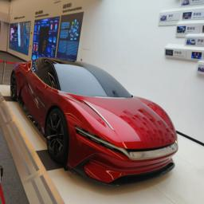




Re-identification

